Slide 1
Report to Community
August 31, 2016

Slide 2
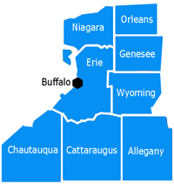
PPS Overview
Attribution: 81,000 patients
Current annual DY budget: $11 million
Categorized as a “small” PPS by NYS Dept of Health
PPS includes all of the providers inside Catholic Medical Partners (CMP); all the hospitals inside Catholic Health System (CHS)
Chautauqua County development is newest area for outreach. Key partners are WCA Hospital, Chautauqua County Health Network, plus Chautauqua Hospice, Chautauqua County Dept of Health.
CMP has a record of successful population health management efforts and value based contracting with managed care organizations.

Slide 3
CPWNY Project Focus Areas by Patient Attribution
(Medicaid Enrollee Estimates by Current DY1 Planned Partner Participation; enrollees attributed to our PPS)
Governance & Infrastructure
Support work streams
Data Systems/IT
Domain 2
2.a.i the IDS (81k)
Hospital / ED Centric Projects
2.c.ii Telemedicine*
2.b.iii ED Triage (30K)
2.b.iv Care Transitions (59K)
Domain 4
Promotional Projects
(no engagement numbers reported; Medicaid enrollee targets not available for Domain 4)
Domain 3
4.a.i Promote MEB
Community / Primary Care Centric Projects
4.b.i Tobacco Cessation
3.a.i PC & Behavioral Health (30k)
3.b.i Cardiovascular Health (19k)
3.g.i Palliative Care (15k)
3.f.i Maternal & Child
(Nurse Family Partnership/CHW Outreach)
* WCA hospital plus specialty linkages (MFM & DD pop)
Community Partners of WNY PPS

Slide 4
Distribution of Funds: Highlights in Organizational Funds Flow
Support Care Management (CM) efforts
CMP Care Management Advisors
CM workflows and data collection via Crimson Care Management module
Promote endorsed guidelines
PCMH efforts
CMP clinical transformation team and Chautauqua County Health Network (CCHN) support
Defray the costs of PCMH fees
Technical team support; data requirements
Outsourced vendor to establish secure data access and storage for state data
Workforce
Rural-AHEC, working with MCC
Reporting and monitoring workforce impacts
Cultural Competency Health Literacy
Training strategy development and team from Community Health Worker Network

Slide 5
Leadership within the community: Maternal Child Health
Mercy Comprehensive Care Center (Article 28 freestanding clinic) and Urban League launching maternal health outreach efforts. Use of Community Health Workers Network for program design and training
Urban League hiring community health workers to close gaps in care, perform appointment follow-ups (e.g. effect HEDIS outcomes measures)
Maternal Fetal Medicine (MFM) review of ultrasounds for WCA hospital; providing clinically appropriate review via telemedicine systems.

Slide 6
Leadership within the community: Behavioral Health in PCP locations
Horizon Health Services and Spectrum Human Services engaging with primary care practices to support behavioral health and care management activities at primary care sites.
Behavioral health staff located inside the primary care setting; become part of the care team for the PCP office.
Focus on the warm transfer to behavioral health locations
“Foot in the door” strategy due to regulatory restrictions (Article 28 and Article 31 co-location)

Slide 7
Leadership within the community: Palliative Care Integration Across 3 Counties
Hospice organizations from Erie, Chautauqua, and Niagara providing education to providers and accepting referrals from practices in all three counties
DSRIP funds are supporting education efforts and team for outreach to primary care practices

Slide 8
Funds Flow: Additional Key Collaborations
Promote Mental, Emotional, and Behavioral (MEB) Well-Being project: managing with our neighboring PPS, Millennium Collaborative Care
15 organizations contracted with CPWNY; focused on same project plan and outreach efforts
All contracts executed, partners including but not limited to:

Slide 9
Funds Flow: Additional Key Collaborations
WCA Hospital
Providing care management staff to effect success in primary care linkages (ED)
Telemedicine key partners, specialists on call (SOC) as well as MFM support
Chautauqua County Health Network (CCHN)
Partner in PCMH work with high volume Medicaid sites in the region
Supporting the policies of the Cardiovascular Care project (3bi) in their clinical integration program
Leadership in technical assistance to practices
Providers in Chautauqua (7 practices) have received participation payments to help defray costs associated with project efforts
Reporting challenges
PCMH effort
Primary care linkages

Slide 10
DSRIP Revenue to date
As of end of DY1 CPWNY had the potential to earn $11,642,656, it was awarded 99.2% of the available payments ($11,555,093) from New York State in DY1.*
PPS budget model linked to outcomes measurement and attribution
Initiatives and projects with the highest effect on measurement year outcomes (e.g. HEDIS outcomes, project outcomes) and the potential to reach the most patients in our attribution receive the highest budget allocation.
Once contracts executed with community partners, funds flow immediately based on expenses incurred and reported.
*All equity program payments are assumed amounts from MCOs until actually received

Slide 11
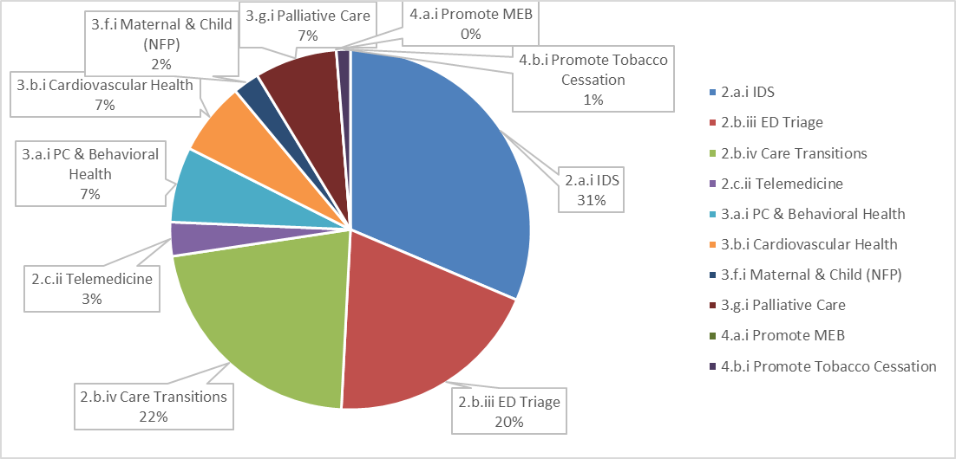
Distributed Revenue by Project DY1 Q4

Slide 12
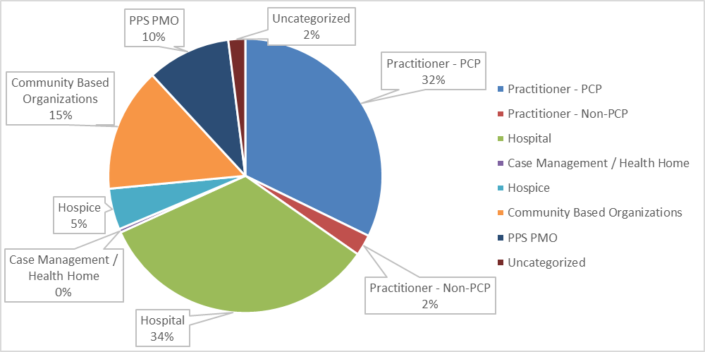
Distributed Revenue by Partner Type DY1 Q4
Administrative Cost is estimated at 21% in DY1 and 18% in DY2 through DY5.

Slide 13
Missed Revenue: Opportunities for Improvement
Missed patient engagement targets
ED Triage, 2bii
Telemedicine, 2cii
Palliative Care Integration in Primary Care, 3gi
Community Partners of WNY PPS

Slide 14
Patient engagement: ED triage
Evolving definition of engagement was a challenge for this project
Targets for this project developed with health home referrals in mind
Definition became more focused on Care Management and Primary Care follow-up appointment
Crimson Care Management module workflow tool to be used for connecting patients to services
Assist patient in finding a PCP
Focus on follow-up with assigned Health Home (a recruitment to HH)
Address social determinates of health via social work and potential CHW interventions
Collect data on high ED utilizers to inform future primary care initiatives and interventions

Slide 15
Patient engagement: Telemedicine
Specialists on Call
Outsourced solution for Neurology critical care consults
Challenges with credentialing; time intensive
Maternal Fetal Medicine (MFM)
Potential to see a larger volume of patients than outsourced solution
Other initiatives for targeted populations
Triage assessment for developmentally disabled population prior to ED visit

Slide 16
Patient engagement: Palliative Care Integration in Primary Care
Project teams experience increased referral volume when staff is present at designated primary care sites. With a noticeable difference in referral volumes, teams create weekly embedding schedules at high volume practices.
Hospice Buffalo developed and piloted a tool for Medent EMRs to identify patients appropriate for palliative care services. This will allow PCPs to begin palliative care conversations at upcoming visit.
CPWNY project team reached out to fellow PPSs to share best practice. (i.e. tracking palliative care services by PCP staff) Goal is to develop report with key practices, including but not limited to:
symptom management
advanced care planning
completion of a MOLST form
Improved coordination with Hospice/palliative care staff

Slide 17
Focus on community strengths!
Project leads are staff at contracted entities
Chautauqua County Dept. of Health key partner in project 3fi
Cultural Competency training assistance via Community Health Worker Network
Create a structure that supports unplanned requests from the state
Mid-Point Assessment: 12 multi-page narratives, 360 Evaluations, on-site visits
Medical Records Review process requires network management support
Reporting tools changing every quarter and requesting additional detail

Slide 18
Be strategic in reporting to provider partners, focus on what is needed “right now”
communication fatigue
talk to providers via existing channels
rely on known team support and established committees
get to know the office managers
Payment methods will change
Managing equity contracts and payer communication
Budget uncertainty

Slide 19
For program design, prototype and pilot, evaluate often and be flexible
New territory for PPS partners and NYS; learn from each other and try new things
Small teams can work in parallel to test multiple pilots

Slide 20
Looking ahead: Managing beyond the 5-year program
Establish data interoperability within the continuum of care, to create seamless delivery of services, both medical and non-medical (social determinates of health). For example:
Patient record can be viewed by care team in any location at provider discretion
Social determinates of health included in the medical record and reviewed by medical care team
Social programs available in real time to address barriers to healthy lifestyle and outcomes.
Outcomes measures are reviewed by practice care teams in collaboration with key community entities.
Discussions inform value based purchasing and future negotiations with MCOs.
Achieve the deliverable of at least 80% VBP across the network.

Slide 21
Looking ahead: Managing beyond a 5-year program
Support PCMH (or APC), Health Home, and Hospital-based care management through data collection, community based outreach, and a robust referral network for addressing social determinants of health.
Primary care system is stronger with consumer-driven qualities, with a focus on delivering care at convenient locations, with technologies that support quality outcomes and improved communication with care team.
Culturally competent care and training continues.
Practices and care teams delivering high quality culturally competent care will be recognized and rewarded
Establishment of lasting community partnerships to drive value and quality improvement

Slide 22
Thank you!
Questions
More info at wnycommunitypartners.org

